Slide 1



Pega Claims FNOL Application
First Notice of Loss | Production Release 1
Project Trinity Team

Slide 2
Dual-Track Evolution: Connecting Customer Ease with Handler Intelligence
Unified Release Scope
Seamless Customer Journey
Production Release 1 introduces a harmonized system architecture bridging external policyholders and internal operations
Anonymous, web-based self-service portal allowing policyholders to submit claims without login friction
AI-Augmented Operations
Strategic Handoff
Pega provides a semi-automated environment where AI handles image analysis and document extraction
Robust manual integration point into Libra system ensuring investigative data is captured accurately and traceable

Slide 3




The End-User Journey: A Four-Stage Path from Web to Confirmation
Stage 4 — Instant Resolution
Stage 3 — Validation & Submission
Stage 2 — Structured Intake
Stage 1 — Digital Entry
Immediate claim reference number on-screen plus confirmation email for peace of mind
Review screen allows edits before submit, automated duplicate check ensures data integrity
Users start at talktotrinity.com and select 'Make a claim', redirecting to Pega Constellation self-service portal with anonymous DX web form access
4-stage form flow — 'Your details' for identification, 'What happened' for incident context, 'Items affected' for loss assessment, 'Evidence' for documentation

Slide 4

Optimizing Accessibility: Key Features for the Modern Policyholder
Frictionless Anonymous Access
Authorized Submission Flexibility
No login required maximizes participation and speed for immediate loss reporting
Supports submissions by authorized representatives on behalf of policyholders
Intelligent Evidence Handling
Proactive Duplicate Detection
At least one affected item required but evidence uploads optional to prevent technical hurdles
System identifies potential duplicates and provides guidance to contact claims team

Slide 5



The Handler Workflow: A Connected Chain of AI-Driven Enrichment
1
2
3
4
Automated Case Creation
Rapid Image Analysis
Policy Schedule Retrieval
Manual System Bridge
Case generated in Pega, automated email with claim details and evidence sent to hello@talktotrinity.com
AI performs background analysis on uploaded photos (5-10 seconds) to identify damage patterns and enrich the case
Within 2-3 hours, system receives policy schedule email, Pega parses and AI extracts core policy data auto-populating the case
At Investigation stage, handler manually creates entry in Libra and links unique Libra ID via local action

Slide 6
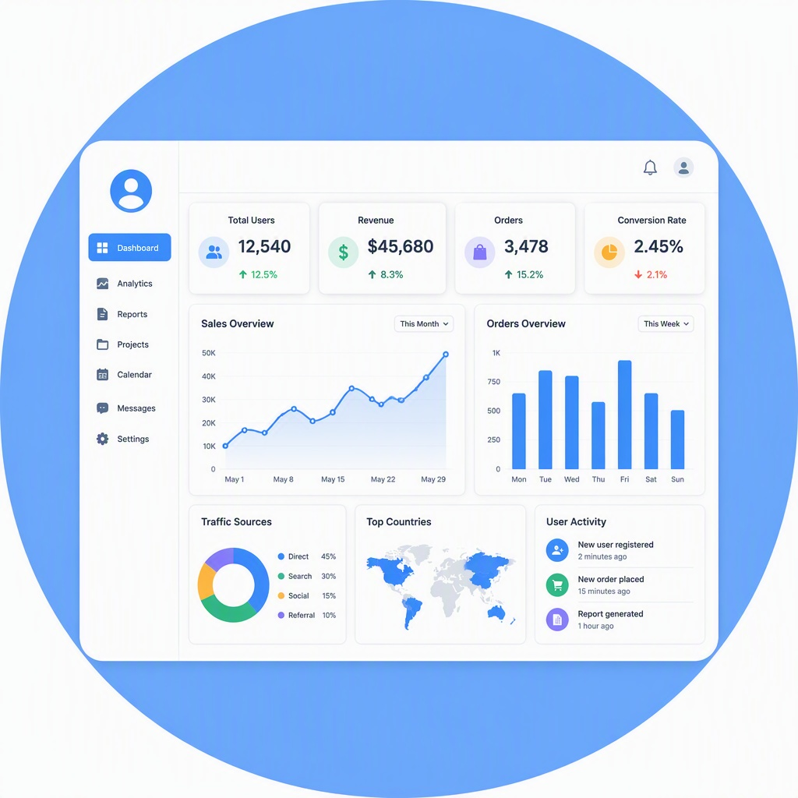



Empowering Productivity: Specialized Tools for the Modern Claim Handler
Structured 360-Degree View
Comprehensive Document Management
Robust Audit Integrity
AI-Enhanced Data Extraction
Dedicated tabs for personal details, claim specifics, and attachments always one click away
Full audit trail of all inbound/outbound emails and attachments for compliance
Automated extraction from policy schedules and damaged-item photos reducing manual work
Attachments gallery allows viewing and downloading all evidence within the case

Slide 7

AI Capabilities Spotlight: Driving Efficiency through Intelligence
Intelligent Image Inspection
Automated Document Parsing
Advanced vision AI processes damaged-item photos for preliminary assessment, accelerating verification
NLP extracts and populates key data fields from policy schedule attachments with high accuracy
Drastic Reduction in Manual Labor
Outcome-Focused Speed
AI touchpoints eliminate re-keying and photo categorization, freeing handlers for complex tasks
Background processes occur in 5-10 seconds so handlers see pre-populated insights when opening cases

Slide 8
Transparency in Transition: Defining the Current Manual Scope
Investigation Initiation (Manual Creation)
System Linking (Local Action)
Handlers manually initiate the case in Libra to ensure data validation during transition
Linking Libra ID via dedicated UI action ensures clean data bridge without complex API sync
Scope Framing (Release Design)
These manual steps are intentional for stability while preparing infrastructure for future automation
Operation
Execution Mode in Release 1
Strategic Rationale
Investigation Initiation (Manual Creation)
Handlers manually initiate the case in Libra to ensure data validation during transition
Ensures data quality and validation during the transition period
System Linking (Local Action)
Linking Libra ID via dedicated UI action ensures clean data bridge without complex API sync
Maintains clean data bridge without complex API synchronization
Scope Framing (Release Design)
These manual steps are intentional for stability while preparing infrastructure for future automation
Intentional design for stability and future automation readiness
Key Takeaway: This intentional manual handoff ensures high data quality and system stability during initial production rollout while defining boundaries for future automation phases.

Slide 9
The Technical Ecosystem: A Unified Map of System Interactions
talktotrinity.com
Trinity Email System
Public-facing gateway with 'Make a claim' entry point and seamless redirect to secure portal
Communication backbone handling inbound policy schedules and outbound confirmation emails
Pega Constellation
Libra Investigation
AI Analysis Engines
Downstream system of record for deep investigation, connected via manual ID-linking process
Distributed services for image recognition and document extraction feeding enriched data back to Pega

Slide 10




Business Value: Quantifying the Impact of Production MVP 1
Accelerated Intake Velocity
1
24/7 self-service portal with anonymous access eliminates phone queues and enables complete claim submissions
Operational Efficiency Gains
2
AI-assisted enrichment and automated data extraction reduce average handling time per case
Core Value
Enhanced Data Integrity
3
Automated duplicate detection and structured form validation ensure clean, relevant data reaching investigation
Full Lifecycle Traceability
4
Unique claim reference numbers and comprehensive audit trail provide total visibility and compliance

Slide 11
Looking Ahead: The Strategic Roadmap Beyond MVP 1
MVP Release 1 (Current)
Following Launch
Future Phase
Long-term Vision
Libra Integration: evaluation of deep API-level integration with Libra to automate investigation record creation and achieve touchless handoff
Stabilization of self-service intake portal, deployment of AI image and document extraction, established manual bridge to Libra investigation system
Post-production review and tuning of AI extraction models based on real-world document variety
Full end-to-end FNOL automation with straight-through processing for simple claims and expanded AI including predictive fraud detection

Slide 12

Thank You
We invite your questions as we move forward into this new chapter of AI-assisted claims excellence.

